Slide 1
Graduate Artificial Intelligence CS 640 Introduction to Neural Networks
Jeffrey Considine
jconsidi@bu.edu

Slide 2
Plan for Today
Learning by optimization
Learning by gradient descent
Learning hidden Markov models (time dependent)
Neural networks
Universal approximation

Slide 3
What do we mean when we say learning?
???

Slide 4
Learning Models ~ Picking Best Function Matching Data
Which function is best?
Which functions do we consider as possible best functions?

Slide 5
Learning Models ~ Picking Best Function Parameters
Given a functional form or function family, what parameters correspond to the function with the best loss?
For example, if we choose the family of linear functions, so y=mx+b is our functional form, then what are the best values of m and b to match the target function?

Slide 6
Empirical Risk Minimization
Empirical risk minimization is the principle that models should be optimized to reduce the empirical risk on the training data, as such models are most likely to perform well on similar data.
Risk=loss in this context. Empirical risk = training loss.
Explicit assumption that “real” data will have same distribution as training data.
Overfitting concern?

Slide 7
Training vs Test Loss
Observation: training loss is skewed low. Why?
Best practice: train on some data, test on different data.
What does it mean if training and test loss are significantly different?

Slide 8
Training vs Validation Loss
How do we decide what kind of model to use without looking at training or test losses?
Can we overfit on validation data?

Slide 9
How Do We Pick the Best Parameters?
???

Slide 10
Any Questions?
Moving on
???
Learning by optimization
Learning by gradient descent
Learning hidden Markov models
Neural networks
Universal approximation

Slide 11
Randomized Parameter Choices?
???

Slide 12
Gradient Descent
Idea: compute partial derivatives of loss with respective to every model parameter.
The vector of all these partial derivatives is called the gradient.
Update model parameters using the gradient to identify direction of decrease.

Slide 13
Stochastic Gradient Descent
Observation: computing the gradient for a 1B row data set is slow.
Question 1: Do we need to do that for each step of gradient descent?
Question 2: Can we approximate the gradient more cheaply?

Slide 14
Benefits of Stochastic Gradient Descent
Speed?
Better solution?

Slide 15
Any Questions?
Moving on
???
Learning by optimization
Learning by gradient descent
Learning hidden Markov models
Neural networks
Universal approximation

Slide 16
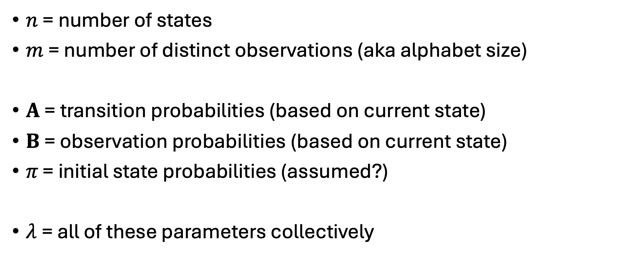
Formalizing Hidden Markov Models (recap)
$n$ = number of states
$m$ = number of distinct observations (aka alphabet size)
$A$ = transition probabilities (based on current state)
$B$ = observation probabilities (based on current state)
$π\text{ = }\text{initial} \text{state} \text{probabilities}$ (assumed?)
$λ$= all of these parameters collectively

Slide 17

Formalizing Hidden Markov Models (cont)
$O=[o_{0},o_{1},…,o_{T−1}]$ observations (known)
$Q=[q_{0},q_{1},…, q_{T−1}]$ true states (unknown)

Slide 18

Learning Problem for HMMs
What hidden Markov model would be most likely to produce these observations $O$?
What is ${argmax}_{λ}{\operatorname{Pr}\left[O | λ\right]}$?

Slide 19
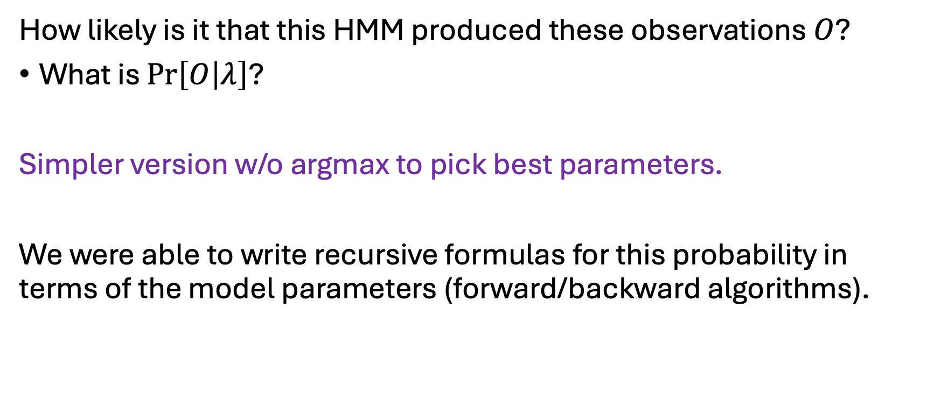
Evaluation Problem for HMMs
How likely is it that this HMM produced these observations $O$?
What is $\operatorname{Pr}\left[O | λ\right]$?
Simpler version w/o argmax to pick best parameters.
We were able to write recursive formulas for this probability in terms of the model parameters (forward/backward algorithms).

Slide 20
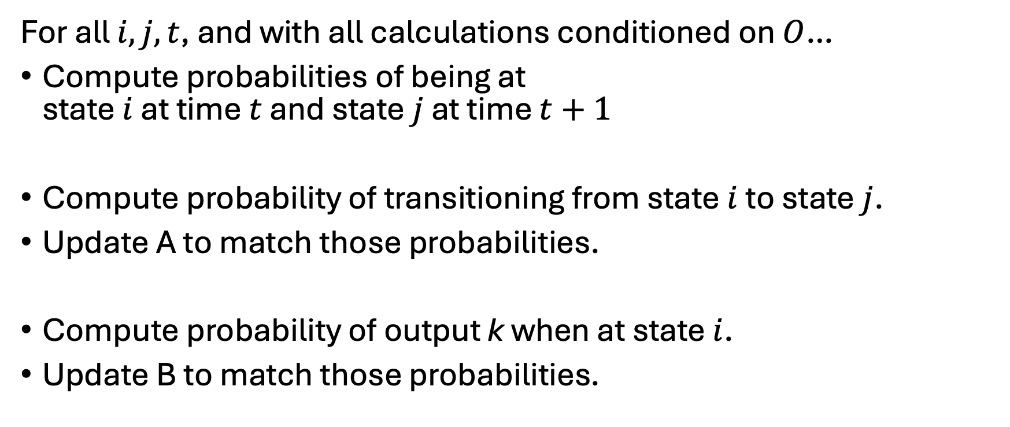
Baum-Welch Algorithm
For all $i, j, t$, and with all calculations conditioned on $O$…
Compute probabilities of being at state $i$ at time $t$ and state $j$ at time $t+1$
Compute probability of transitioning from state $i$ to state $j$.
Update A to match those probabilities.
Compute probability of output k when at state $i$.
Update B to match those probabilities.

Slide 21
What if we did not think that through?
Totally glossed over why that process makes sense…
Is there a conceptually easier way?

Slide 22
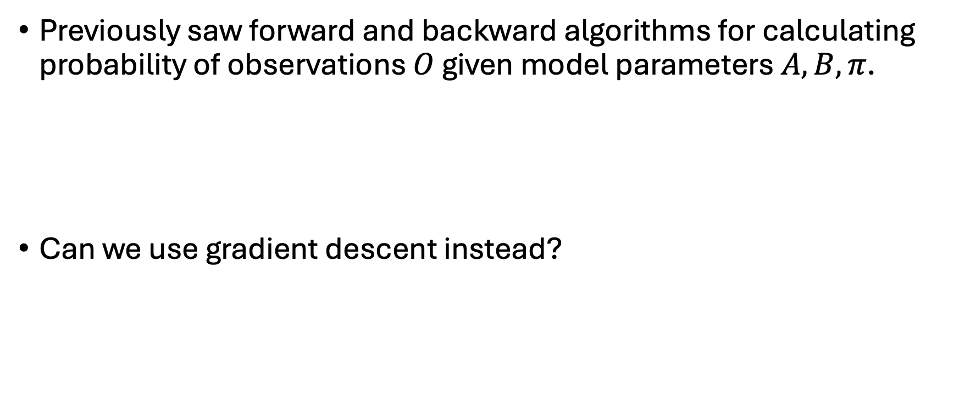
Learning the Hidden Markov Model with Gradient Descent
Previously saw forward and backward algorithms for calculating probability of observations $O$ given model parameters $A, B, π$.
Can we use gradient descent instead?

Slide 23
Probability Constraints
Gradient descent does not know that pi vector should add up to one. Same issues for rows of A and B.
What will gradient descent do?

Slide 24

Logistic Function
Standard logistic function:
$$f\left(x\right)=\frac{1}{1+e^{−x}}$$
Equivalent formulas:
$$f\left(x\right)=\frac{e^{x}}{e^{x}+1}$$
$$f\left(x\right)=\frac{e^{x}}{e^{x}+e^{0}}$$

Slide 25
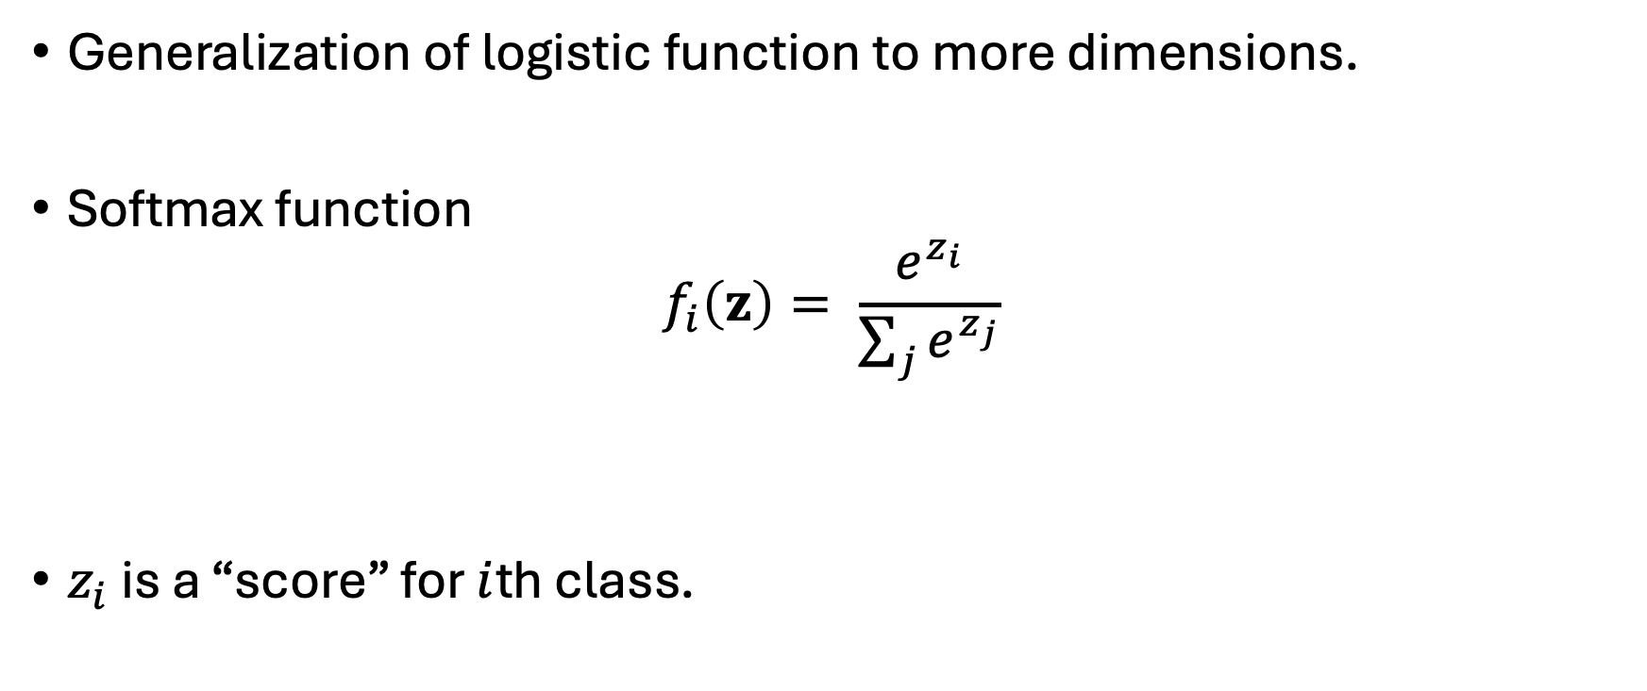
Softmax Solution
Generalization of logistic function to more dimensions.
Softmax function
$$f_{i}\left(z\right)= \frac{e^{z_{i}}}{\sum_{j}{e^{z_{j}}}}$$
$z_{i}$ is a “score” for $i$th class.

Slide 26
Is Gradient Descent a Good Way to Learn HMMs?
Generally, no, since we have analytical solutions for EM steps.
And they are pretty fast.
Baum-Welch has weakness that it might converge to non-optimal solution.
Gradient descent has this problem too.
Gradient descent is preferred more often when we do not have an analytical solution, or the analytical solution is slow.

Slide 27
Any Questions?
Moving on
???
Learning by optimization
Learning by gradient descent
Learning hidden Markov models
Neural networks
Universal approximation

Slide 28
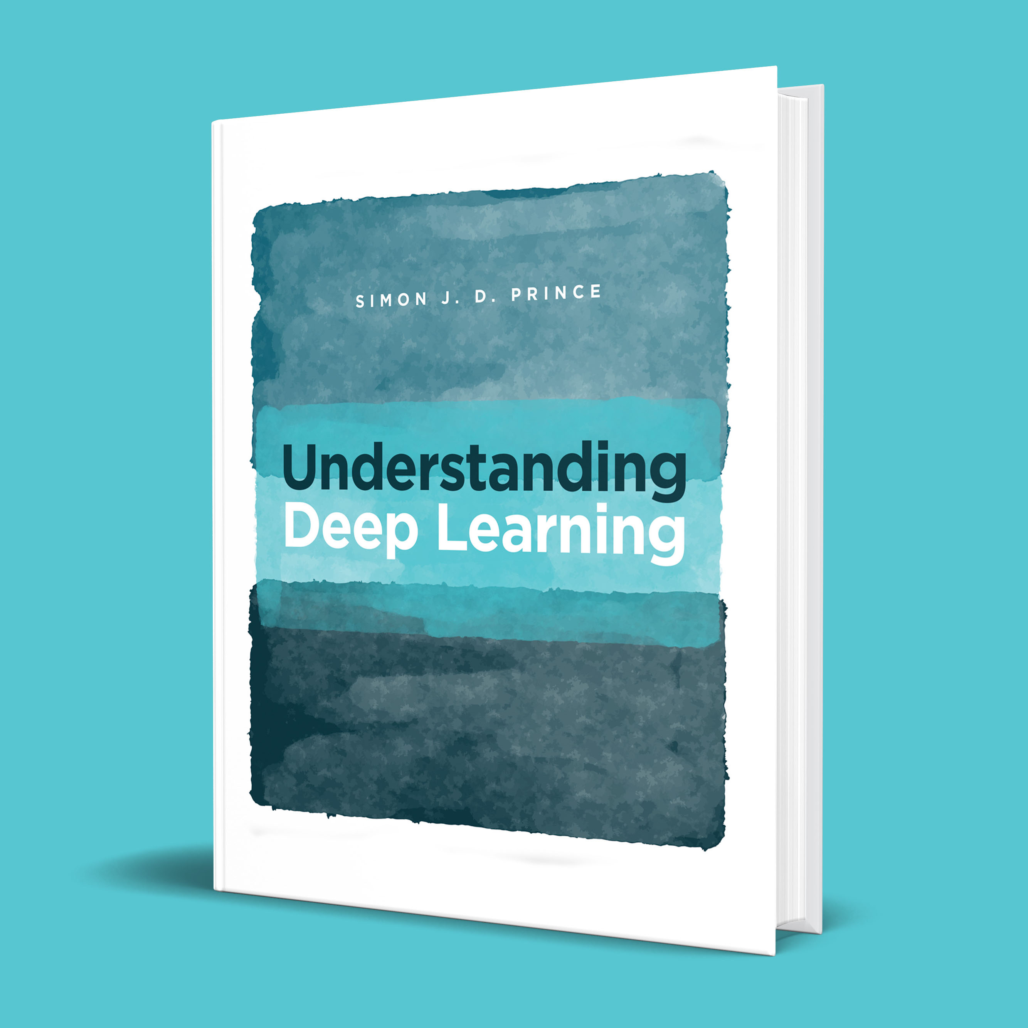
Another Textbook for Neural Network Material
Understanding Deep Learning by Simon Prince
https://udlbook.com/
Linked in Blackboard with chapter references
Many slides today were made for this book.

Slide 29
1D Linear Regression
Example shallow network
Slide originally by Simon Prince

Slide 30
Example shallow network
Slide originally by Simon Prince

Slide 31
Example shallow network
Activation function
Slide originally by Simon Prince

Slide 32
Purpose of Activation Functions
Activation functions are needed for non-linearities.
Using constant activation functions gives constant outputs.
Using linear activation functions gives linear outputs.
Using polynomial activation functions gives polynomial outputs.
Need a non-polynomial activation function!

Slide 33
Example shallow network
Activation function
Rectified Linear Unit
(particular kind of activation function)
Slide originally by Simon Prince

Slide 34
Example shallow network
Activation function
Rectified Linear Unit
(particular kind of activation function)
Slide originally by Simon Prince

Slide 35
Example shallow network
This model has 10 parameters:
Represents a family of functions
Parameters determine a particular function
Given parameters can perform inference (run equation)
Given training dataset
Define loss function (least squares)
Change parameters to minimize loss function
Slide originally by Simon Prince

Slide 36
Example shallow network
Slide originally by Simon Prince

Slide 37
Example shallow network
Piecewise linear functions with three joints
Slide originally by Simon Prince

Slide 38
Hidden units
Break down into two parts:
where:
Hidden units
Slide originally by Simon Prince

Slide 39
1. compute three linear functions
Slide originally by Simon Prince

Slide 40
2. Pass through ReLU functions (creates hidden units)
Slide originally by Simon Prince

Slide 41
2. Weight the hidden units
Slide originally by Simon Prince

Slide 42
4. Sum the weighted hidden units to create output
Slide originally by Simon Prince

Slide 43
Example shallow network
Example shallow network = piecewise linear functions
1 “joint” per ReLU function
Slide originally by Simon Prince

Slide 44
Activation pattern = which hidden units are activated
Shaded region:
Unit 1 active
Unit 2 inactive
Unit 3 active
Slide originally by Simon Prince

Slide 45
Depicting neural networks
Each parameter multiplies its source and adds to its target
Slide originally by Simon Prince

Slide 46
Depicting neural networks
Slide originally by Simon Prince

Slide 47
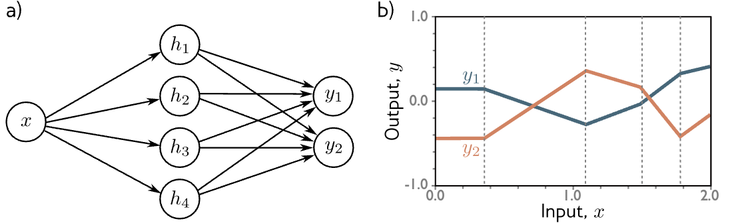
Two outputs
1 input, 4 hidden units, 2 outputs
Slide originally by Simon Prince

Slide 48
Two inputs
2 inputs, 3 hidden units, 1 output
Slide originally by Simon Prince

Slide 49
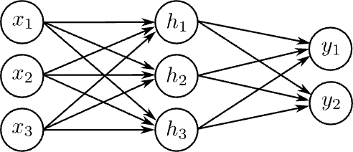
Arbitrary inputs, hidden units, outputs
$D_{o}$Outputs, D hidden units, and $D_{i}$ inputs
e.g., Three inputs, three hidden units, two outputs
Slide originally by Simon Prince

Slide 50
Any Questions?
Moving on
???
Learning by optimization
Learning by gradient descent
Learning hidden Markov models
Neural networks
Universal approximation

Slide 51
With 3 hidden units:
With D hidden units:
Slide originally by Simon Prince

Slide 52
With enough hidden units…
… we can describe any 1D function to arbitrary accuracy
Slide originally by Simon Prince

Slide 53
Universal approximation theorem
“a formal proof that, with enough hidden units, a shallow neural network can describe any continuous function on a compact subset of to arbitrary precision”
Slide originally by Simon Prince

Slide 54
Any Questions?
???
Learning by optimization
Learning by gradient descent
Learning hidden Markov models
Neural networks
Universal approximation

